Slide 1
Capstone project 1: predicting customer turnout
Robert Vagi

Slide 2
Problem statement
Accurately forecasting customer turnout is critical for a successful restaurant.
Recruit Holdings has access to unique datasets that may make automated future customer prediction possible.
These include information on restaurant reservations, number of daily customers, and rich restaurant-specific information.
In this project, I draw from these and other data sources to predict the total number of visitors to a restaurant on a given date.
This information will help restaurants:
be more efficient with regard to both purchasing and staffing.
free up resources so that restaurants can focus on creating an enjoyable dining experience for their customers.

Slide 3
data
Data for this project came from AirREGI/Restaurant Board (AIR) system.
AIR is a digital reservation and cash register system.
Time series data that spanned January, 2016 through April, 2017.

Slide 4
Data
In these data, the following was provided for each restaurant:
Air_store_id - the restaurant's id in the air system Visit_datetime - the time of the reservation Reserve_datetime - the time the reservation was made Reserve_visitors - the number of visitors for that reservation Air_genre_name - type of restaurant
Air_area_name - region where the store is located Latitude - approximate latitude of the restaurant Longitude - approximate longitude of the restaurant Visitors - the number of visitors to the restaurant on the date

Slide 5
data
I supplemented the AIR reservation data with calendar and weather data that included the following:
Calendar_date - date of each reservation Day_of_week - day of the week for each calendar date
Holiday_flg - indicates that the day is a holiday in Japan
Avg_temperature - average daily temperature at the weather station closest to each restaurant
High_temperature - daily high temperature at the weather station closest to each restaurant
Low_temperature - daily low temperature at the weather station closest to each restaurant
Precipitation - daily precipitation total at the weather station closest to each restaurant
Hours_sunlight - daily hours of sunlight at the weather station closest to each restaurant

Slide 6
Data wrangling
Data were downloaded via Kaggle’s API.
These included reservation data, visitor data, restaurant information, calendar information, and weather data.
Visitor Data:
The visitor data contained the variable of interest: number of visitors for each transaction.
Visitor data were grouped by restaurant, resampled by day, and the number of visitors was summed for each restaurant on each day.
This process was repeated with reservation data, but the number of reservations were counted for each day.

Slide 7
Data wrangling
Restaurant Data:
Because the visitor data contained the outcome of interest, restaurant information were left-jointed to the visitor data.
This ensured that all of the relevant visitor data was retained and irrelevant reservation data was excluded.

Slide 8
Data wrangling
Weather Data:
Daily weather data were stored in separate files for each weather station.
Weather station ids were provided in the file names, but were not contained as data in the files.
Used a function that read each file into an empty list while simultaneously creating an id variable generated from the id in the filename.
This list was concatenated to create a single weather data frame where each observation contained unique day-weather station observations.
Using a crosswalk provided through the Kaggle community, I then linked the restaurant data to the daily weather data for the nearest weather station.

Slide 9
Data Wrangling
Excluded variables with large percentage of missing values (reservations, missing = 76%)
Replaced missing weather data with daily, global median
Replaced extreme outliers (greater than +/- 3.5 standard deviations from the mean) with 3.5 standard deviations above/below the mean
These were calculated using each restaurant’s reservation data
This eliminated extreme residuals and retained information about values in the extremes of the range.

Slide 10
Data Wrangling
Created/included the following features:
Rolling means, medians, and standard deviations for each restaurant with 7-day lag
Average daily temperature, daily high temperature, daily low temperature, precipitation, and hours of sunlight
Continue variables for day of the month and day of the week
Dummy variables for each region, restaurant genre, day of the month, and day of the week
The number of restaurants in each region as a proxy for restaurant competition

Slide 11
Exploratory Data analysis
There were 296,279 unique day-restaurant observations in the dataset.
The data contained daily observations from Friday, January 1st, 2016 through Saturday, April 22nd, 2017.
The data contained information for 829 restaurants in 103 neighborhoods.

Slide 12
Exploratory data analysis
The ten neighborhoods with the most restaurants are listed below.
Neighborhood | Number of Restaurants
Fukuoka-ken Fukuoka-shi Daimyō | 64
Tōkyō-to Shibuya-ku Shibuya | 58
Tōkyō-to Minato-ku Shibakōen | 51
Tōkyō-to Shinjuku-ku Kabukichō | 39
Tōkyō-to Setagaya-ku Setagaya | 30
Tōkyō-to Chūō-ku Tsukiji | 29
Ōsaka-fu Ōsaka-shi Ōgimachi | 25
Hiroshima-ken Hiroshima-shi Kokutaijimachi | 23
Tōkyō-to Meguro-ku Kamimeguro | 22
Hokkaidō Sapporo-shi Minami 3 Jōnishi | 21

Slide 13

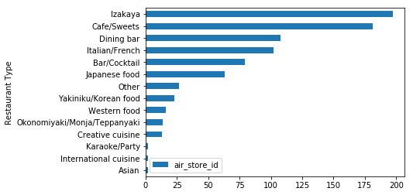
Exploratory data analysis
Restaurants represented 14 ‘genres.’
‘Izakaya’ and ‘Café/Sweets’ were the most common genres.

Slide 14
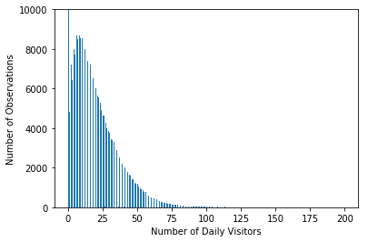
Exploratory data analysis
Descriptive Statistics:
n: 296,279
Mean: 17.8
Std: 16.6
Min: 0.0
25th percentile: 5.0
50th percentile: 14.0
75th percentile: 26.0
Max: 199.9
Note: There were a large number of observations with zero visitors (44,171).

Slide 15
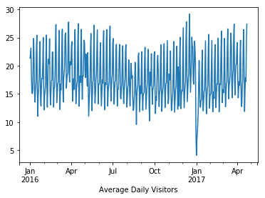
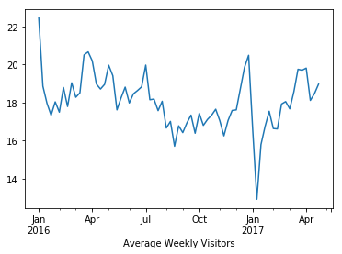
Exploratory data analysis
There are seasonal trends both within and across months. The number of visitors is highest in April through July, December, and January.
The months between August through November seem to slow down for restaurants.

Slide 16
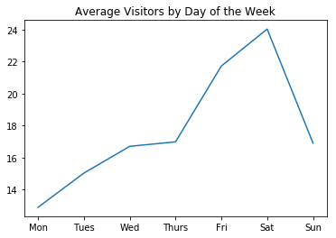
Exploratory data analysis
Monday is the slowest day of the week. The average number of visitors increases steadily throughout the week and drops sharply on Sunday.

Slide 17
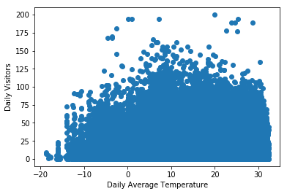
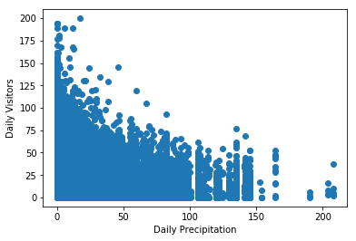
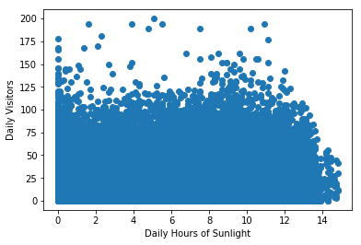
Exploratory data analysis
There appears to be a slight positive relationship between average daily visitors and average daily temperature and a negative relationship between average daily visitors and daily precipitation. There does not appear to be a relationship between average daily visitors and hours of sunlight.

Slide 18
Exploratory data analysis
Day of Week | Coefficient/Std. Err
Tuesday | 0.30*** (0.01)
Wednesday | 0.42*** (0.01)
Thursday | 0.49*** (0.01)
Friday | 0.80*** (0.01)
Saturday | 0.83*** (0.01)
Sunday | 0.10*** (0.01)
R-squared = .05***
* = p < .05, ** = p < .01, *** = p < .001
Question: Are the observed differences in average visitors by day of the week significantly different from one another?
Note: Monday is used as the reference category.
Results: Each day of the week had significantly more visitors, on average, compared to Mondays. The pattern of the coefficients reflects the pattern shown in the graphical analysis.

Slide 19
Exploratory data analysis
Question: Which features are significantly correlated with the target variable (i.e. number of visitors per day)
Results: All features except for high-temperature were significantly related to the number of restaurant visitors. By far, the strongest relationships were with the lagged ‘naive’ features with correlations ranging .48 to .64.
Variable | Correlation with Number of Visitors
avg_temperature | -.01**
high_temperature | -.00
low_temperature | -.01***
precipitation | -.04***
hours_sunlight | .04***
day_of_month | .03***
rolling_mean_lag | .61***
rolling_median_lag | .58***
rolling_std_lag | .48***
visitors_lag | .64***
competition | -.03***
* = p < .05, ** = p < .01, *** = p < .001

Slide 20
Model Building and selection
Base Model: Extreme Gradient Boosting (XGBoost’s Python API), random forests as base learner
Training Data: all observation between January 1st, 2016 and March 27th, 2017 (Note: target caps outliers at 3.5 std’s above restaurant mean)
Test Data: all observation between March 28th, 2017 and April 22nd, 2017 (Note: target includes outcome with outliers included)
Tuned Hyperparameters: subsample, n_estimators, colsample_bytree, learning rate, and max_depth
Initial Specification: All features described previously as predictors and target as outcome
Tuned Hyperparameters: subsample, n_estimators, colsample_bytree, learning rate, and max_depth
Results: Model RMSE = 13.9, Median-Estimated RMSE = 18.9
Issues: Residuals followed a linear trend with low-turnout days overpredicted and high-turnout days underpredicted

Slide 21
Model Building and selection
Revised Model:
Created features to reflect average number of visitors per restaurant, average number of visitors per restaurant per day, and dummy indicators for high- and low-turnout restaurants
These were created from the training data and imputed into the test data to ensure no contamination between training and test data.
Two extreme outliers were removed from the test data to give a more accurate RMSE
Results: Model RMSE = 10.5, Median-Estimated RMSE = 18.1
Residuals: Non-normal about tails, but centered at zero with no apparent trends

Slide 22
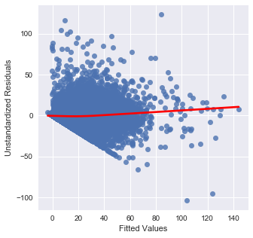
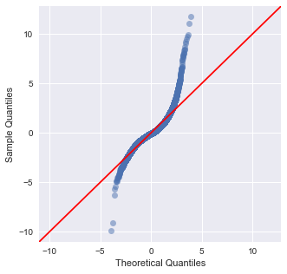
Model Building and selection
Residual Plots:

Slide 23
Model Building and selection
Additional Model:
Log+1 transformed the target
Recalculated features to reflect log transformation
Exponentiated the predicted and observed test targets to calculated RMSE that was comparable to the previous models
Results: Model RMSE = 12.1, Median-Estimated RMSE = 18.1
Conclusion: Accept the non-transformed model since it produced the smallest RMSE

